Slide 1
Types of Probability Samples
Condensed from Sampling: Design and Analysis 2e by S Lohr

Slide 2
simple random sample (SRS)
stratified random sample
cluster sample
systematic sample
Condensed from Sampling: Design and Analysis 2e by S Lohr

Slide 3
Simple random sample (SRS)
An SRS of size n is taken when every possible subset of n units in the population has the same chance of being the sample.
SRSs serve as the foundation for more complex sampling designs.
In taking a random sample, the investigator is in effect mixing up the population before grabbing n units.
Condensed from Sampling: Design and Analysis 2e by S Lohr

Slide 4
Stratified random sample
In a stratified random sample, the population is divided into subgroups called strata.
An SRS is selected from each stratum, and the SRSs in the strata are selected independently.
The strata are often subgroups of interest to the investigator.
Condensed from Sampling: Design and Analysis 2e by S Lohr

Slide 5
Stratified random sample
For example, the strata might be
  different regions of the country in a survey of people,
  different types of terrain in an ecological survey, or
  sizes of firms in a business survey.
Elements in the same stratum often tend to be more similar than randomly selected elements from the whole population.
Condensed from Sampling: Design and Analysis 2e by S Lohr

Slide 6
Cluster sample
In a cluster sample, observation units in the population are aggregated into larger sampling units, called clusters.
Suppose you want to survey market stall owners in Metro Manila but do not have a list of all stall owners in the metropolis, so you cannot take an SRS.
However, you do have a list of all the markets.
You can then take an SRS of the markets and then subsample all or some stall owners in the selected markets.
Condensed from Sampling: Design and Analysis 2e by S Lohr

Slide 7
Cluster sample
In this case, the markets form the clusters, and the stall owners are the observation units.
It is more convenient to sample at the market level; however, stall owners of the same market may have more similarities than stall owners selected at random.
So a cluster sample of 500 stall owners may not provide as much information as an SRS of 500 such owners.
Condensed from Sampling: Design and Analysis 2e by S Lohr

Slide 8
Framework for Probability Sampling
Consider a finite population, or universe, of N units is denoted by the index set U = {1, 2, …, N}.
Out of this population we can choose various samples, which are subsets of U.
The particular sample chosen is denoted by S, a subset consisting of n of the units in U.
Condensed from Sampling: Design and Analysis 2e by S Lohr

Slide 9
Example
Suppose the population has four units: U = {1, 2, 3, 4}.
Six different samples of size 2 could be chosen from this population:
  S₁ = {1, 2} S₄ = {2, 3}
  S₂ = {1, 3} S₅ = {2, 4}
  S₃ = {1, 4} S₆ = {3, 4}
In probability sampling, each possible sample S from the population has a known probability P(S) of being chosen, and the probabilities of the possible samples sum to 1.
Condensed from Sampling: Design and Analysis 2e by S Lohr

Slide 10
Example
One possible sample design for a probability sample of size 2 would have P(S₁)=1/3, P(S₂)=1/6, and P(S₆)=1/2, and P(S₃)=P(S₄)=P(S₅)=0.
The probabilities P(S₁), P(S₂), and P(S₆) of the possible samples are known before the sample is drawn.
  One way to select the sample would be to place six labeled balls in a box; two of the balls are labeled 1, one is labeled 2, and three are labeled 6.
  Now choose one ball at random; if a ball labeled 6 is chosen, then S₆ is the sample.
Condensed from Sampling: Design and Analysis 2e by S Lohr

Slide 11
Example
In a probability sample, since each possible sample has a known probability of being the chosen sample, each unit in the population has a known probability of appearing in our selected sample.
We calculate
π_{i} = P(unit i in sample) (2.2)
by summing the probabilities of all possible samples that contain unit i.
Condensed from Sampling: Design and Analysis 2e by S Lohr

Slide 12
In probability sampling, the π_{i} are known before the survey commences, and we assume that π_{i} > 0 for every unit in the population.
For the sample design just described,
π₁ = P(S₁)+ P(S₂) + P(S₃) = 1/2,
π₂ = P(S₁) + P(S₄) + P(S₅) = 1/3,
π₃ = P(S₂) + P(S₄) + P(S₆) = 2/3, and
π₄ = P(S₃) + P(S₅) + P(S₆) = 1/2.
Condensed from Sampling: Design and Analysis 2e by S Lohr

Slide 13
Of course, we never write all possible samples down and calculate the probability with which we would choose every possible sample—this would take far too long.
But such enumeration underlies all of probability sampling.
Investigators using a probability sample have much less discretion about which units are included in the sample, so using probability samples helps us avoid some of the selection biases
Condensed from Sampling: Design and Analysis 2e by S Lohr

Slide 14
In a probability sample, the interviewer cannot choose to substitute a friendly looking person for the grumpy person selected to be in the sample by the random selection method.
A forester taking a probability sample of trees cannot simply measure the trees near the road but must measure the trees designated for inclusion in the sample.
Taking a probability sample is much harder than taking a convenience sample, but a probability sampling procedure guarantees that each unit in the population could appear in the sample and provides information that can be used to assess the precision of statistics calculated from the sample.
Condensed from Sampling: Design and Analysis 2e by S Lohr

Slide 15
Within the framework of probability sampling, we can quantify how likely it is that our sample is a “good” one.
A single probability sample is not guaranteed to be representative of the population with regard to the characteristics of interest, but we can quantify how often samples will meet some criterion of representativeness.
Condensed from Sampling: Design and Analysis 2e by S Lohr

Slide 16
The notion is the same as that of confidence intervals
We do not know whether the particular 95% confidence interval we construct for the mean contains the true value of the mean.
We do know, however, that if the assumptions for the confidence interval procedure are valid and if we repeat the procedure over and over again, we can expect 95% of the resulting confidence intervals to contain the true value of the mean.
Similarly, if y_{i} be a characteristic associated with the ith unit in the population, we consider y_{i} to be a fixed quantity; if Farm 723 is included in the sample, then the amount of palay produced on Farm 723, y₇₂₃, is known exactly.
Condensed from Sampling: Design and Analysis 2e by S Lohr

Slide 17
Most results in sampling rely on the sampling distribution of a statistic, the distribution of different values of the statistic obtained by the process of taking all possible samples from the population.
A sampling distribution is an example of a discrete probability distribution.
Condensed from Sampling: Design and Analysis 2e by S Lohr

Slide 18
E X A M P L E 2.2
Consider an artificial situation in which we know the value of y_{i} for each of the N = 8 units in the whole population.
The index set for the population is
U = {1, 2, 3, 4, 5, 6, 7, 8}.
Condensed from Sampling: Design and Analysis 2e by S Lohr

Slide 19

E X A M P L E 2.2
The values of y_{i} are
There are 70 possible samples of size 4 that may be drawn without replacement from this population
Condensed from Sampling: Design and Analysis 2e by S Lohr

Slide 20
E X A M P L E 2.2
If the sample consisting of units {1, 2, 3, 4} were chosen, the corresponding values of y_{i} would be 1, 2, 4, and 4.
The values of y_{i} for the sample {2, 3, 6, 7} are 2, 4, 7, and 7.
Define P(S)=1/70 for each distinct subset of size four from U.
This design is an SRS without replacement.
Each unit is in exactly 35 of the possible samples, so π_{i} =1/2 for i=1, 2, . . . , 8.
Condensed from Sampling: Design and Analysis 2e by S Lohr

Slide 21
E X A M P L E 2.2
A random mechanism is used to select one of the 70 possible samples.
One possible mechanism for this example, because we have listed all possible samples, is to generate a random number between 1 and 70 and select the corresponding sample.
  With large populations, however, the number of samples is so great that it is impractical to list all possible samples—instead, another method is used to select the sample.
Condensed from Sampling: Design and Analysis 2e by S Lohr

Slide 22
E X A M P L E 2.2
Suppose we want to use a sample to estimate a population quantity, say the population total T = ∑_{i} y_{i}.
One estimator we might use for T is Ť_{S} =Nŷ_{S}, where ŷ_{S} is the average of the y_{i}’s in S, the chosen sample.
In our example, T =40.
If the sample S consists of units 1, 3, 5, and 6, then Ť_{S} =8 x (1 + 4 + 7 + 7)/4=38.
Since we know the whole population here, we can find Ť_{S} for each of the 70 possible samples.
Condensed from Sampling: Design and Analysis 2e by S Lohr

Slide 23
E X A M P L E 2.2
The probabilities of selection for the samples give the sampling distribution of Ť :
P{Ť = k} = ∑_{S:Ť=k}P(S)
i.e., the summation is over all samples S for which Ť_{S} = k.
We know the probability P(S) with which we select a sample S because we took a probability sample.
Condensed from Sampling: Design and Analysis 2e by S Lohr

Slide 24
E X A M P L E 2.2
Four samples ({3,4,5,6}, {3,4,5,7}, {3,4,6,7}, and {1,5,6,7}) result in the estimate Ť =44, so
P{Ť = 44}=4/70.
For this example, we can write out the sampling distribution of Ť because we know the values for the entire population.
Condensed from Sampling: Design and Analysis 2e by S Lohr

Slide 25
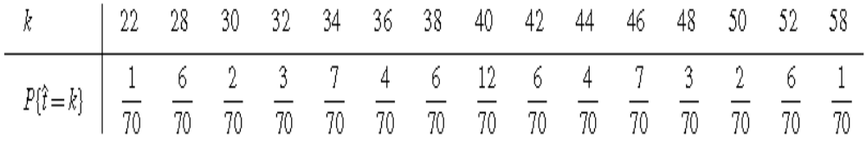
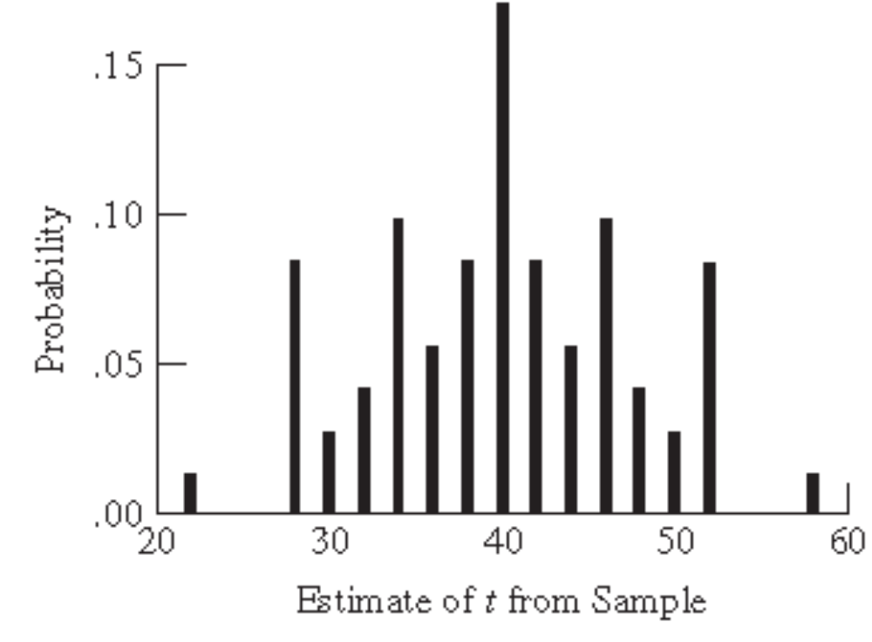
Condensed from Sampling: Design and Analysis 2e by S Lohr

Slide 26
Expected value of an estimator
The expected value of Ť , E[Ť], is the mean of the sampling distribution of Ť :
E[Ť] = ∑_{S} Ť_{S} P(S)
= ∑_{k}k P(Ť= k).
The expected value of the statistic is the weighted average of the possible sample values of the statistic, weighted by the probability that particular value of the statistic would occur.
Condensed from Sampling: Design and Analysis 2e by S Lohr

Slide 27
Estimation Bias
The estimation bias of the estimator Ť is
Bias [Ť] = E[Ť] − T. (2.4)
If Bias[Ť] = 0, we say that the estimator Ť is unbiased for T.
Condensed from Sampling: Design and Analysis 2e by S Lohr

Slide 28
Note that the mathematical definition of bias in (2.4) is not the same thing as the selection or measurement bias described earlier.
All indicate a systematic deviation from the population value, but from different sources.
Condensed from Sampling: Design and Analysis 2e by S Lohr

Slide 29
Selection bias is due to the method of selecting the sample—often, the investigator acts as though every possible sample S has the same probability of being selected, but some subsets of the population actually have a different probability of selection.
With undercoverage, for example, the probability of including a unit not in the sampling frame is zero.
Condensed from Sampling: Design and Analysis 2e by S Lohr

Slide 30
Measurement bias means that the y_{i}’s are not really the quantities of interest, so although Ť may be unbiased in the sense of (2.4) for
T = ∑_{i} y_{i}, T itself would not be the true total of interest.
Condensed from Sampling: Design and Analysis 2e by S Lohr

Slide 31
Estimation bias means that the estimator chosen results in bias—for example, if we used Ť_{S} = ∑ _{iεS} y_{i} and did not take a census, Ť_{S} would be biased.
Condensed from Sampling: Design and Analysis 2e by S Lohr

Slide 32
Variance of an estimator
The variance of the sampling distribution of Ť is
V(Ť) = E[(Ť − E[Ť])²]
= ∑_{S} P(S) [Ť_{S} − E(Ť)]² (2.5)
Condensed from Sampling: Design and Analysis 2e by S Lohr

Slide 33
MSE of an estimator
Because we sometimes use biased estimators, we often use the mean squared error (MSE) rather than variance to measure the accuracy of an estimator
MSE[Ť] = E[(Ť − T)²]
= E[(Ť − E[Ť] + E[Ť] − T)2]
= E[(Ť − E[Ť])²] + (E[Ť] − t)²
+ 2 E[(Ť − E[Ť])(E[Ť] − t)]
= V(Ť) + Bias(Ť)²
Condensed from Sampling: Design and Analysis 2e by S Lohr

Slide 34
Thus, an estimator Ť of T is unbiased if E(Ť)=T, precise if V(Ť)=E[(Ť−E[Ť])2] is small, and accurate if MSE[Ť]=E[(Ť−T)2] is small.
A badly biased estimator may be precise but it will not be accurate; accuracy (MSE) is how close the estimate is to the true value, while precision (variance) measures how close estimates from different samples are to each other.
Condensed from Sampling: Design and Analysis 2e by S Lohr

Slide 35
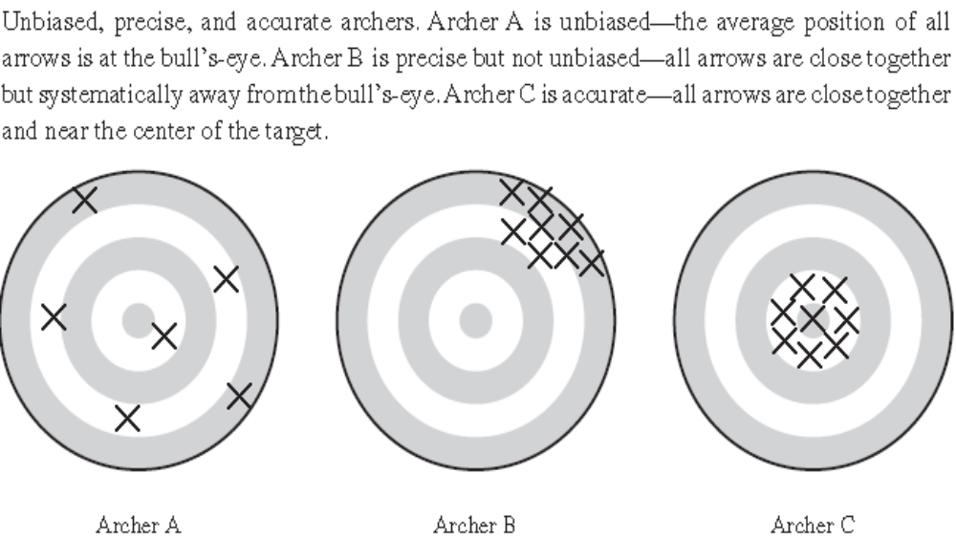
Condensed from Sampling: Design and Analysis 2e by S Lohr

Slide 36
Population Characteristics
You may be interested in many different population quantities from your population.
Historically, however, the main impetus for developing theory for sample surveys has been estimating population means and totals.
Suppose we want to estimate the total number of persons in a region who have diabetes, or the average palay production per hectare.
Condensed from Sampling: Design and Analysis 2e by S Lohr

Slide 37
Population Characteristics
The population total is T = ∑_{i}^{N} y_{i} and the mean of the population is
Ŷ_{U} = ∑_{i}^{N} y_{i} /N
Define the variance of the population values about the mean as
S² = ∑_{i}^{N} (y_{i} − Ŷ_{U})² /(N-1). (2.6)
The population standard deviation is the square root of S².
Condensed from Sampling: Design and Analysis 2e by S Lohr

Slide 38
Simple Random Sampling
A simple random sample with replacement (SRSWR) of size n from a population of N units can be thought of as drawing n independent samples of size 1.
One unit is randomly selected from the population to be the first sampled unit, with probability 1/N.
Then the sampled unit is replaced in the population, and a second unit is randomly selected with probability 1/N.
This procedure is repeated until the sample has n units, which may include duplicates from the population.
Condensed from Sampling: Design and Analysis 2e by S Lohr

Slide 39
Simple Random Sampling
In finite population sampling, however, sampling the same person twice provides no additional information.
We usually prefer to sample without replacement, so that the sample contains no duplicates.
A simple random sample without replacement (SRS) of size n is selected so that every possible subset of n distinct units in the population has the same probability of being selected as the sample.
There are _{N}C_{n} possible samples, and each is equally likely, so the probability of selecting any individual sample S of n units is
P(S) = 1/ _{N}C_{n} = n!(N-n)!/N!
Condensed from Sampling: Design and Analysis 2e by S Lohr

Slide 40
To take an SRS, you need a list of all observation units in the population; this list is the sampling frame.
In an SRS, the sampling unit and observation unit coincide.
Each unit is assigned a number, and a sample is selected so that each possible sample of size n has the same chance of being the sample actually selected.
This can be thought of as drawing numbers out of a hat; in practice, computer-generated pseudo-random numbers are usually used to select a sample.
Condensed from Sampling: Design and Analysis 2e by S Lohr

Slide 41
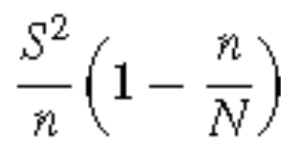
For estimating the population mean Ŷ_{U} from an SRS, we use the sample mean
ŷ_{S} = ∑_{i}^{n}y_{i}. (2.8)
ŷ_{S} is an unbiased estimator of the population mean Ŷ_{U}, and the variance of ŷ_{S} is
V(ŷ_{S}) = (2.9)
Condensed from Sampling: Design and Analysis 2e by S Lohr

Slide 42
The variance V(ŷ_{S}) measures the variability among estimates of Ŷ_{U} from different samples.
The factor (1−n/N) is called the finite population correction (fpc).
Intuitively, we make this correction because with small populations the greater our sampling fraction n/N, the more information we have about the population and thus the smaller the variance.
Condensed from Sampling: Design and Analysis 2e by S Lohr

Slide 43
If N =10 and we sample all 10 bservations, we would expect the variance of y to be 0 (which it is).
If N =10, there is only one possible sample S of size 10 without replacement, with ŷ_{S} = Ŷ_{U}, so there is no variability due to taking a sample.
For a census, the fpc, and hence V(y), is 0.
When the sampling fraction n/N is large in an SRS without replacement, the sample is closer to a census, which has no sampling variability.
Condensed from Sampling: Design and Analysis 2e by S Lohr

Slide 44
For most samples that are taken from extremely large populations, the fpc is approximately 1.
For large populations it is the size of the sample taken, not the percentage of the population sampled, that determines the precision of the estimator.
Condensed from Sampling: Design and Analysis 2e by S Lohr

Slide 45
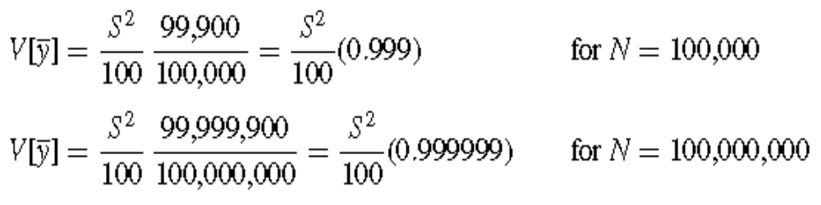
Condensed from Sampling: Design and Analysis 2e by S Lohr

Slide 46
The population variance S², which depends on the values for the entire population, is in general unknown.
We estimate it by the sample variance
s² = ∑_{i}^{n} (y_{i} − ŷ_{S})² /(n-1). (2.10)
Condensed from Sampling: Design and Analysis 2e by S Lohr

Slide 47
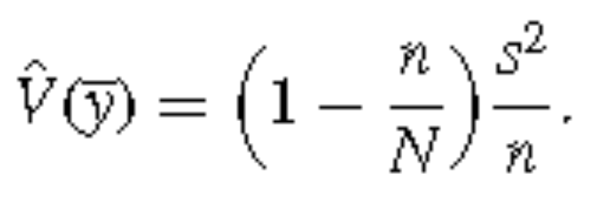
An unbiased estimator of the variance of ŷ_{S} is
(2.11)
Condensed from Sampling: Design and Analysis 2e by S Lohr

Slide 48
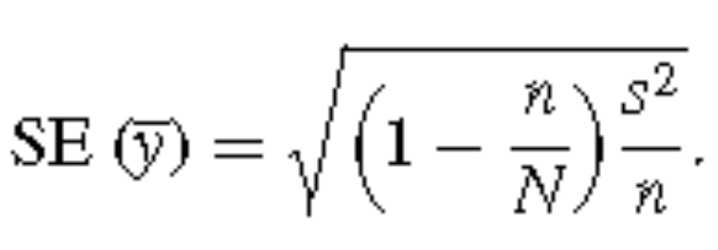
The standard error (SE) is the square root of the estimated variance of ŷ_{S} :
(2.12)
Condensed from Sampling: Design and Analysis 2e by S Lohr

Slide 49
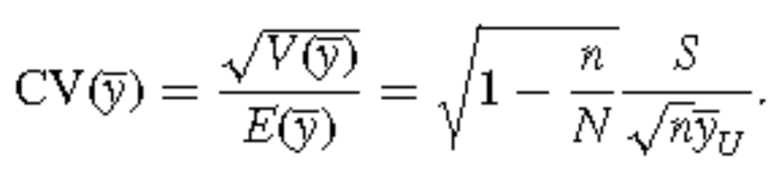
The coefficient of variation (CV) of the estimator ŷ_{S} is a measure of relative variability, which may be defined when Ŷ_{U} ≠ 0 as:
(2.13)
Condensed from Sampling: Design and Analysis 2e by S Lohr

Slide 50
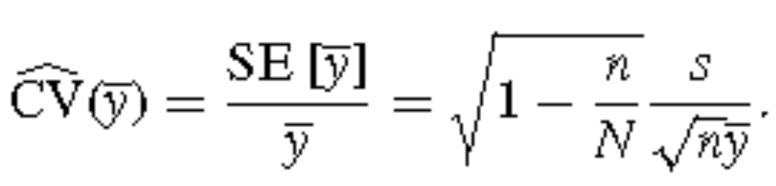
We can estimate the CV of an estimator using the standard error divided by the mean (defined only when the mean is nonzero): In an SRS,
(2.14)
The estimated CV is thus the standard error expressed as a percentage of the mean.
Condensed from Sampling: Design and Analysis 2e by S Lohr

Slide 51


Note:
All the previous results apply to the estimation of a population total, T, since
T
To estimate T, we use the unbiased estimator
Condensed from Sampling: Design and Analysis 2e by S Lohr

Slide 52
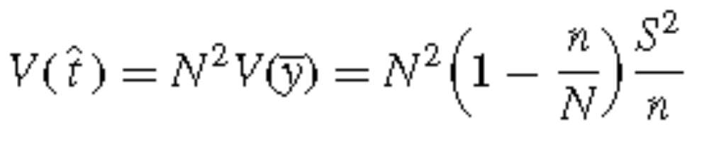
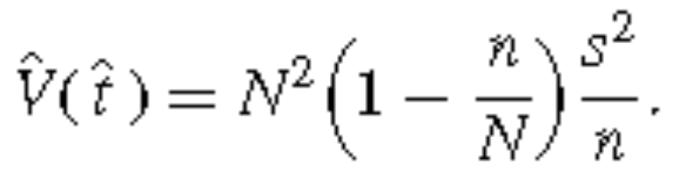
Then
and
Condensed from Sampling: Design and Analysis 2e by S Lohr

Slide 53

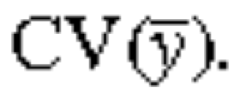
Note:
Also
is the same as
Condensed from Sampling: Design and Analysis 2e by S Lohr

Slide 54
Estimating a proportion
Estimating a proportion is a special case of estimating a mean, the results in (2.8)–(2.14) hold for proportions as well.
Suppose we want to estimate the proportion of units in the population that have some characteristic—call this proportion p.
Define y_{i} to be 1 if the unit has the characteristic and to be 0 if the unit does not have that characteristic.
Condensed from Sampling: Design and Analysis 2e by S Lohr

Slide 55
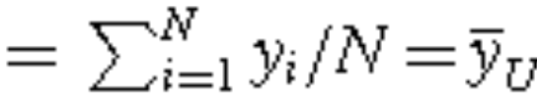

Estimating a proportion
Then p
p is estimated by
Consequently, is an unbiased estimator for p.
Condensed from Sampling: Design and Analysis 2e by S Lohr

Slide 56
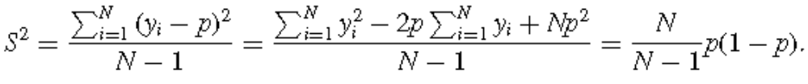
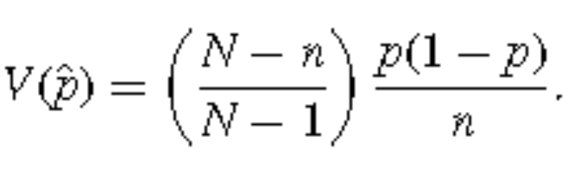
Estimating a proportion
For the response y_{i}, taking on values 0 or 1,
Thus (2.9) implies
Condensed from Sampling: Design and Analysis 2e by S Lohr

Slide 57
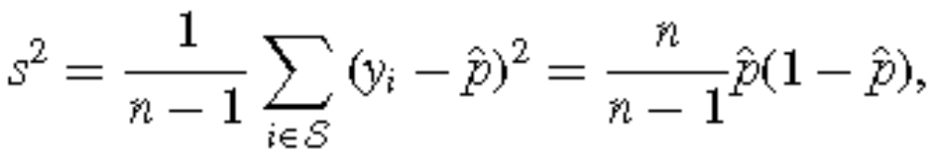

Estimating a proportion
Also,
And so, from (2.11), we have
Condensed from Sampling: Design and Analysis 2e by S Lohr

Slide 58
Note
In an SRS,π_{i} =n/N for all units i=1, . . . , N.
However, many other probability sampling designs also have π_{i} =n/N for all units but are not SRSs.
To have an SRS, it is not sufficient for every individual to have the same probability of being in the sample; in addition, every possible sample of size n must have the same probability 1/_{N}C_{n} of being the sample selected.
Condensed from Sampling: Design and Analysis 2e by S Lohr

Slide 59
2.4 SamplingWeights
Define the sampling weight, for any sampling design, to be the reciprocal of the inclusion probability:
w_{i} = 1/π_{i} (2.20)
The sampling weight of unit i can be interpreted as the number of population units represented by unit i.
Condensed from Sampling: Design and Analysis 2e by S Lohr

Slide 60
2.4 SamplingWeights
In an SRS, each unit has inclusion probability π_{i} =n/N; consequently, all sampling weights are the same with w_{i} =1/π_{i} =N/n.
We can thus think of every unit in the sample as representing itself plus N/n−1 of the unsampled units in the population.
Condensed from Sampling: Design and Analysis 2e by S Lohr

Slide 61
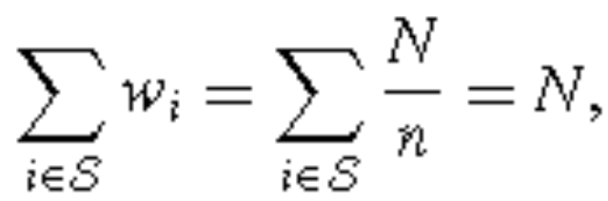
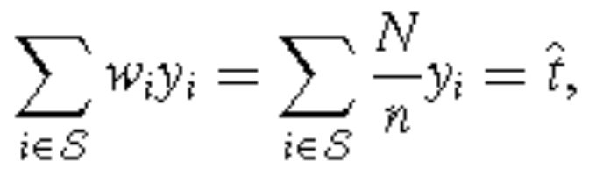
2.4 SamplingWeights
Note that for an SRS,
Condensed from Sampling: Design and Analysis 2e by S Lohr

Slide 62
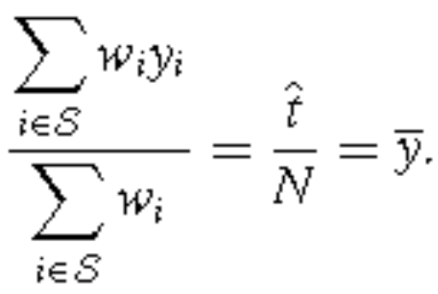
2.4 SamplingWeights
and
All weights are the same in an SRS—that is, every unit in the sample represents the same number of units, N/n, in the population.
We call such a sample, in which every unit has the same sampling weight, a self-weighting sample.
Condensed from Sampling: Design and Analysis 2e by S Lohr

Slide 63
2.5 Confidence Intervals
In statistics, confidence intervals (CIs) are used to indicate the accuracy of an estimate.
A 95% confidence interval is often explained heuristically: If we take samples from our population over and over again, and construct a confidence interval using our procedure for each possible sample, we expect 95% of the resulting intervals to include the true value of the population parameter.
Condensed from Sampling: Design and Analysis 2e by S Lohr

Slide 64
2.5 Confidence Intervals
In probability sampling from a finite population, only a finite number of possible samples exist and we know the probability with which each will be chosen; if we were able to generate all possible samples from the population, we would be able to calculate the exact confidence level for a confidence interval procedure.
Condensed from Sampling: Design and Analysis 2e by S Lohr

Slide 65
2.5 Confidence Intervals
See Example 2.9
In practice, we do not know the values of statistics from all possible samples, so we cannot calculate the exact confidence coefficient for a procedure.
Condensed from Sampling: Design and Analysis 2e by S Lohr

Slide 66
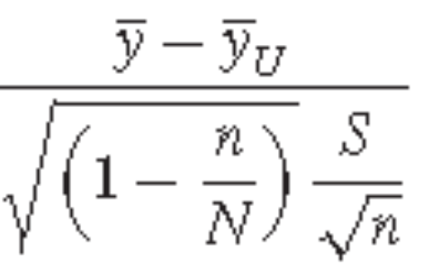
2.5 Confidence Intervals
Hájek’s theorem: if certain technical conditions hold and if n, N, and N − n are all “sufficiently large,” then the sampling distribution of
is approximately std normal
Condensed from Sampling: Design and Analysis 2e by S Lohr

Slide 67

2.5 Confidence Intervals
A large-sample 100(1 − α)% CI for the population mean is
where z_{α/2} is the (1−α/2)th percentile of the standard normal distribution.
Condensed from Sampling: Design and Analysis 2e by S Lohr

Slide 68
2.5 Confidence Intervals
In practice, we often substitute t_{α/2,n−1}, the (1−α/2)th percentile of a t distribution with n−1 degrees of freedom, for z_{α/2}.
For large samples, t_{α/2,n−1} ≈ z_{α/2}.
In smaller samples, using t_{α/2,n−1} instead of z_{α/2} produces a wider CI.
Condensed from Sampling: Design and Analysis 2e by S Lohr

Slide 69

2.5 Confidence Intervals
Most software packages use the following CI for the population mean from an SRS:
Condensed from Sampling: Design and Analysis 2e by S Lohr

Slide 70
2.5 Confidence Intervals
The imprecise term “sufficiently large” occurs in the central limit theorem because the adequacy of the normal approximation depends on n and on how closely the population {y_{i}, i=1, . . . , N} resembles a population generated from the normal distribution.
The “magic number” of n = 30, often cited in introductory statistics books as a sample size that is “sufficiently large” for the central limit theorem to apply, often does not suffice in finite population sampling problems.
Condensed from Sampling: Design and Analysis 2e by S Lohr

Slide 71
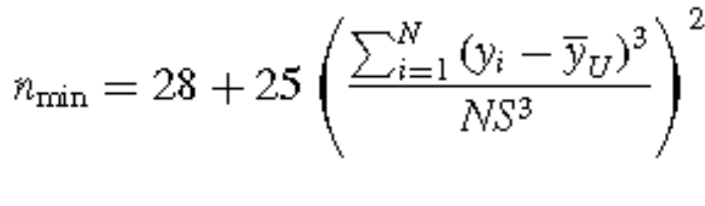
2.5 Confidence Intervals
Sugden et al. (2000) recommended a minimum sample size of
to have confidence level approximately equal to 1−α.
Condensed from Sampling: Design and Analysis 2e by S Lohr

Slide 72

2.5 Confidence Intervals
The quantity is the skewness of the population; if the skewness is large, a large sample size is needed for the normal approximation to be valid.
Condensed from Sampling: Design and Analysis 2e by S Lohr

Slide 73
2.6 Sample Size Estimation
Survey
  Several variables measured
  Multiple goals/objectives
SRS
  must decide what amount of sampling error in the estimates is tolerable and
  must balance the precision of the estimates with the cost of the survey.
Condensed from Sampling: Design and Analysis 2e by S Lohr

Slide 74
2.6 Sample Size Estimation
Even though many variables may be measured, an investigator can often focus on one or two responses that are of primary interest in the survey, and use these for estimating a sample size.
Condensed from Sampling: Design and Analysis 2e by S Lohr

Slide 75
2.6 Sample Size Estimation
For a single response, Lohr recommends these steps to estimate the sample size:
1 Ask “What is expected of the sample, and how much precision do I need?”
  What are the consequences of the sample results?
  How much error is tolerable?
  If your survey measures the unemployment rate every month, you would like your estimates to be very precise indeed so that you can detect changes in unemployment rates from month to month.
Condensed from Sampling: Design and Analysis 2e by S Lohr

Slide 76
2.6 Sample Size Estimation
1 Ask “What is expected of the sample, and how much precision do I need?”
  A preliminary investigation, however, often needs less precision than an ongoing survey.
  Instead of asking about required precision, many people ask, “What percentage of the population should I include in my sample?” This is usually the wrong question to be asking.
  Except in very small populations, precision is obtained through the absolute size of the sample, not the proportion of the population covered.
  Recall: the fpc, which is the only place that the population size N occurs in the variance formula, has little effect on the variance of the estimator in large populations.
Condensed from Sampling: Design and Analysis 2e by S Lohr

Slide 77
2.6 Sample Size Estimation
2 Find an equation relating the sample size n and your expectations of the sample.
3 Estimate any unknown quantities and solve for n.
Condensed from Sampling: Design and Analysis 2e by S Lohr

Slide 78
2.6 Sample Size Estimation
4 If you are relatively new at designing surveys, you will find at this point that the sample size you calculated in step 3 is much larger than you can afford.
  Go back and adjust some of your expectations for the survey and try again.
  In some cases, you will find that you cannot even come close to the precision you need with the resources you have available; in that case, perhaps you should consider whether you should even conduct your study.
Condensed from Sampling: Design and Analysis 2e by S Lohr

Slide 79
2.6 Sample Size Estimation
Specify the Tolerable Error
Only the investigators in the study can say how much precision is needed.
The desired precision is often expressed in absolute terms, as
The investigator must decide on reasonable values for α and e, the margin of error
For many surveys of people in which a proportion is measured, e=0.03 and α=0.05.
Condensed from Sampling: Design and Analysis 2e by S Lohr

Slide 80
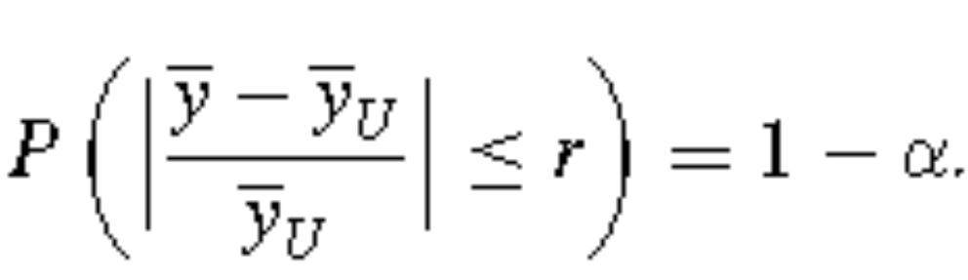
2.6 Sample Size Estimation
Specify the Tolerable Error
If a the goal is to achieve a desired relative error, then the precision is expressed via
Condensed from Sampling: Design and Analysis 2e by S Lohr

Slide 81
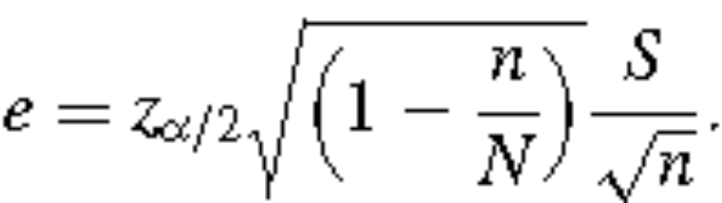
2.6 Sample Size Estimation
Find an Equation
To obtain absolute precision e, find a value of n that satisfies
Condensed from Sampling: Design and Analysis 2e by S Lohr

Slide 82
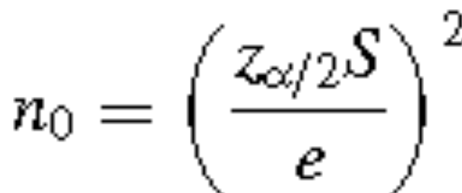
2.6 Sample Size Estimation
To solve this equation for n, we first find the sample size n₀ that we would use for an SRSWR:
Condensed from Sampling: Design and Analysis 2e by S Lohr

Slide 83
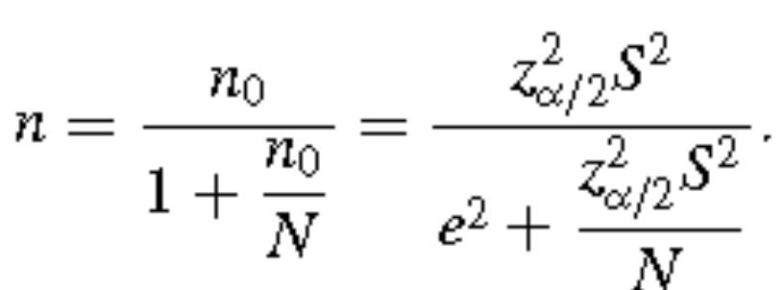
2.6 Sample Size Estimation
Then the desired sample size is
(Think of fpc as the efficiency of SWSWOR relative to SWSWR)
if n₀ ≥N we simply take a census with n=N.
See Example 2.11 p.47
Condensed from Sampling: Design and Analysis 2e by S Lohr

Slide 84
2.6 Sample Size Estimation
In surveys in which one of the main responses of interest is a proportion, it is often easiest to use that response in setting the sample size.
For large populations, S² ≈ p(1 − p), which attains its maximal value when p=1/2.
Using n₀ =1.962/(4e2) will result in a 95% CI with width at most 2e.
Condensed from Sampling: Design and Analysis 2e by S Lohr

Slide 85
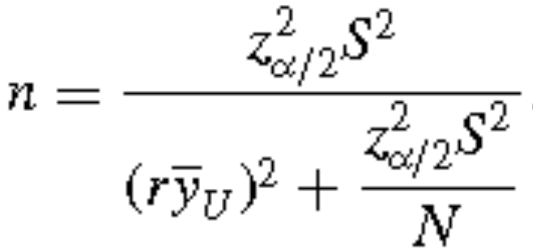
2.6 Sample Size Estimation
To obtain a specified relative precision r, substitute for e
Condensed from Sampling: Design and Analysis 2e by S Lohr

Slide 86
2.6 Sample Size Estimation
Estimate unknown quantities.
When interested in a proportion, we can use 1/4 as an upper bound for S².
For other quantities, S² must be estimated or guessed at.
Condensed from Sampling: Design and Analysis 2e by S Lohr

Slide 87
2.6 Sample Size Estimation
Some methods for estimating S² include:
1 Use sample quantities obtained when pretesting your survey.
  This is probably the best method, as your pretest should be similar to the survey you take.
  A pilot sample, a small sample taken to provide information and guidance for the design of the main survey, can be used to estimate quantities needed for setting the sample size.
Condensed from Sampling: Design and Analysis 2e by S Lohr

Slide 88
2.6 Sample Size Estimation
2 Use previous studies or data available in the literature.
  You are rarely the first person in the world to study anything related to your investigation.
  You may be able to find estimates of variances that have been published in related studies, and use these as a starting point for estimating your sample size.
  But you have no control over the quality or design of those studies, and their estimates may be unreliable or may not apply for your study.
  In addition, estimates may change over time and vary in different geographic locations.
Condensed from Sampling: Design and Analysis 2e by S Lohr

Slide 89
2.6 Sample Size Estimation
3 If nothing else is available, guess the variance.
  Sometimes a hypothesized distributionof the data will give us information about the variance.
  For example, if you believe the population to be normally distributed, you may not know what the variance is, but you may have an idea of the range of the data.
  You could then estimate S by range/4 or range/6, as approximately 95% of values from a normal population are within 2 standard deviations of the mean, and 99.7% of the values are within 3 standard deviations of the mean.
Condensed from Sampling: Design and Analysis 2e by S Lohr

Slide 90
2.7 Systematic Sampling
Sometimes systematic sampling is used as a proxy for simple random sampling, when no list of the population exists or when the list is in roughly random order.
However, systematic sampling is not the same as simple random sampling; it does not have the property that every possible group of n units has the same probability of being the sample.
Condensed from Sampling: Design and Analysis 2e by S Lohr

Slide 91
2.7 Systematic Sampling
If the population is in random order, the systematic sample will behave much like an SRS, and SRS methods can be used in the analysis.
Systematic sampling does not necessarily give a representative sample, though, if the listing of population units is in some periodic or cyclical order.
  If male and female names alternate in the list, for example, and k is even, the systematic sample will contain either all men or all women—this cannot be considered a representative sample.
Condensed from Sampling: Design and Analysis 2e by S Lohr

Slide 92
2.7 Systematic Sampling
On the other hand, some populations are in increasing or decreasing order.
A list of accounts receivable may be ordered from largest amount to smallest amount.
  In this case, estimates from the systematic sample may have smaller (but unestimable) variance than comparable estimates from the SRS.
Condensed from Sampling: Design and Analysis 2e by S Lohr

Slide 93
2.7 Systematic Sampling
In systematic sampling, we must still have a sampling frame and be careful when defining the target population.
  Sampling every 20th student to enter the library will not give a representative sample of the student body.
  Sampling every 10th person exiting an airplane, though, will probably give a representative sample of the persons on that flight.
Condensed from Sampling: Design and Analysis 2e by S Lohr

Slide 94
2.8 Randomization Theory Results for SRS
In the randomization theory (also called design-based) approach to sampling, the y_{i}’s are considered to be fixed but unknown numbers—the random variables used in randomization theory inference indicate which population units are in the sample.
Condensed from Sampling: Design and Analysis 2e by S Lohr

Slide 95
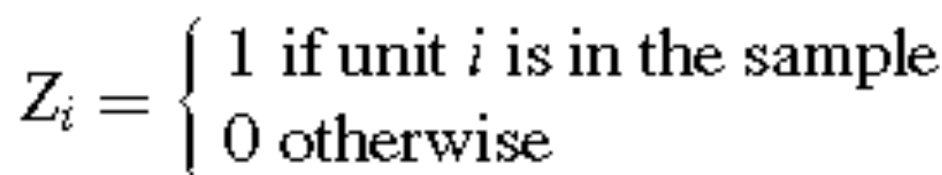
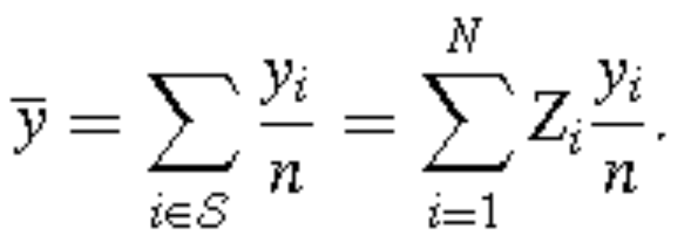
2.8 Randomization Theory Results for SRS
Define
then
Condensed from Sampling: Design and Analysis 2e by S Lohr

Slide 96
2.8 Randomization Theory Results for SRS
The Z_{i}’s are the only random variables because, according to randomization theory, the y_{i}’s are fixed quantities.
When we choose an SRS of n units out of the N units in the population, {Z₁, . . . , Z_{N}} are identically distributed Bernoulli random variables with π_{i} = P(Z_{i} = 1) = P(select unit i in sample).
Condensed from Sampling: Design and Analysis 2e by S Lohr

Slide 97
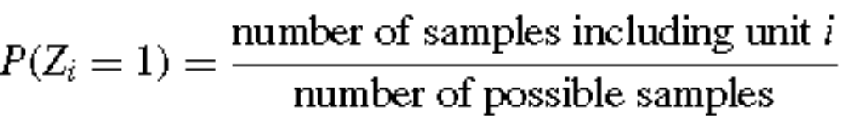
2.8 Randomization Theory Results for SRS
Note that if unit i is in the sample, then the other n−1 units in the sample must be chosen from the other N −1 units in the population.
A total of _{N-1}C_{n−1} possible samples of size n − 1 may be drawn from a population of size N − 1, so
= _{N-1}C_{n−1} / _{N}C_{n} = n/N
Condensed from Sampling: Design and Analysis 2e by S Lohr

Slide 98
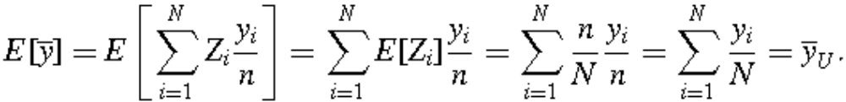
2.8 Randomization Theory Results for SRS
So, E[Z_{i}] = E[Z_{i}² ] = n/N
and that
Condensed from Sampling: Design and Analysis 2e by S Lohr

Slide 99
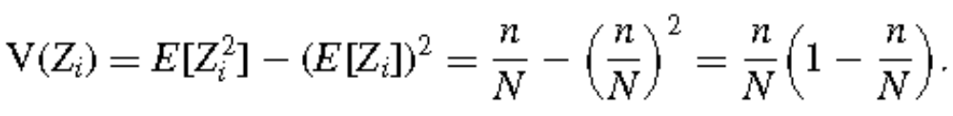
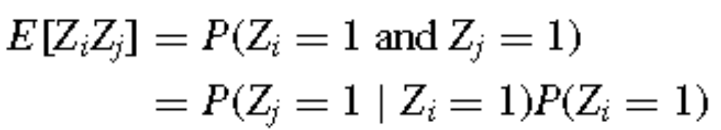
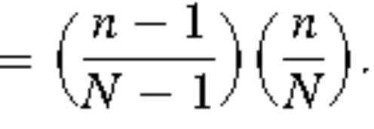
2.8 Randomization Theory Results for SRS
To derive the variance of the sample mean, first note that
And for i ≠ j
Condensed from Sampling: Design and Analysis 2e by S Lohr

Slide 100
2.8 Randomization Theory Results for SRS
Because the population is finite, the Z_{i}’s are not quite independent—if we know that unit i is in the sample, we do have a small amount of information about whether unit j is in the sample, reflected in the conditional probability P(Zj =1 | Zi =1).
Condensed from Sampling: Design and Analysis 2e by S Lohr

Slide 101
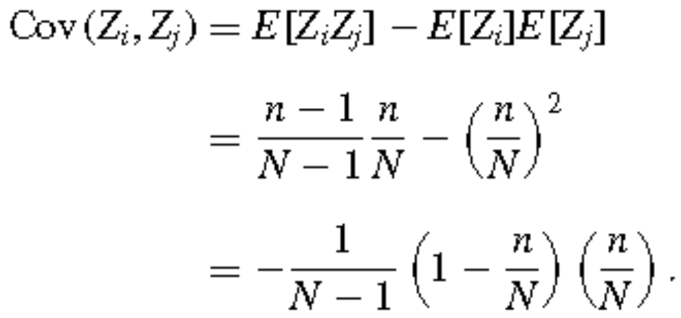
2.8 Randomization Theory Results for SRS
Consequently, for i ≠ j, the covariance of Z_{i} and Z_{j} is
The negative covariance of Z_{i} and Z_{j} is the source of the fpc.
Condensed from Sampling: Design and Analysis 2e by S Lohr

Slide 102
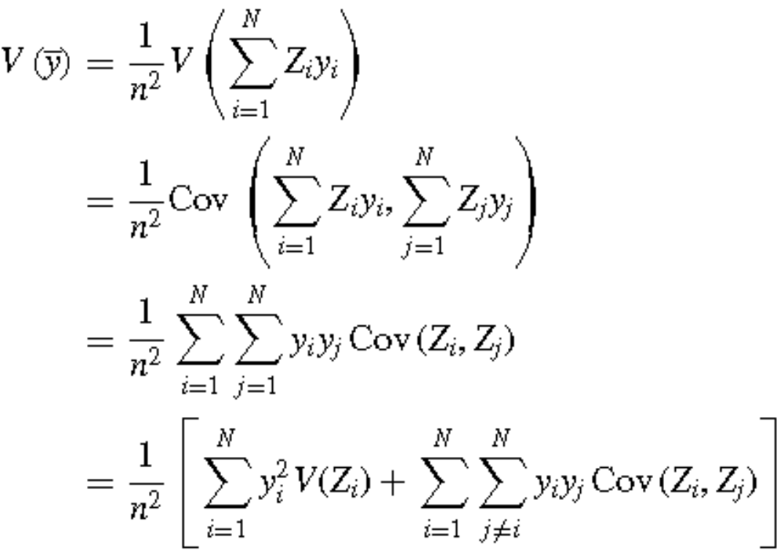
2.8 Randomization Theory Results for SRS
Condensed from Sampling: Design and Analysis 2e by S Lohr

Slide 103
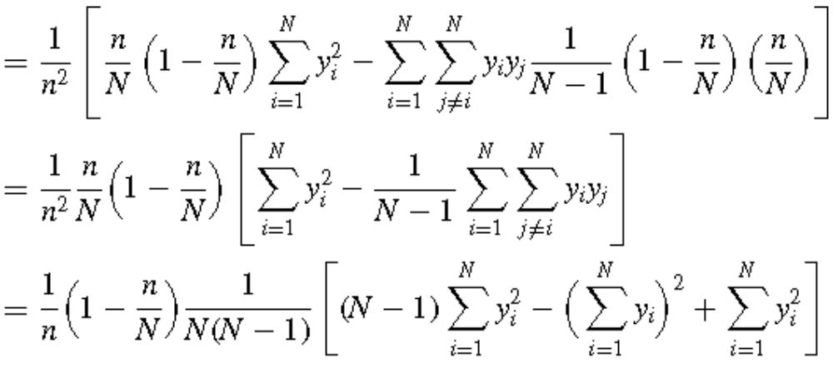
2.8 Randomization Theory Results for SRS
Condensed from Sampling: Design and Analysis 2e by S Lohr

Slide 104
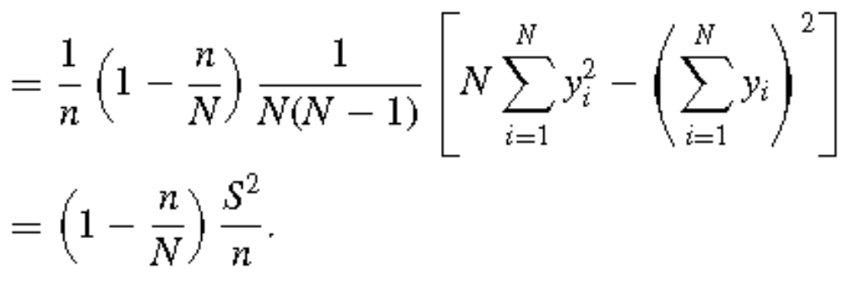
2.8 Randomization Theory Results for SRS
Condensed from Sampling: Design and Analysis 2e by S Lohr

Slide 105
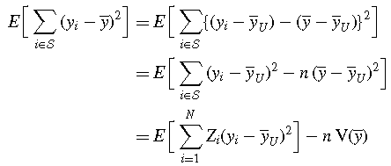
2.8 Randomization Theory Results for SRS
Condensed from Sampling: Design and Analysis 2e by S Lohr

Slide 106
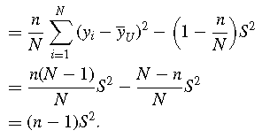
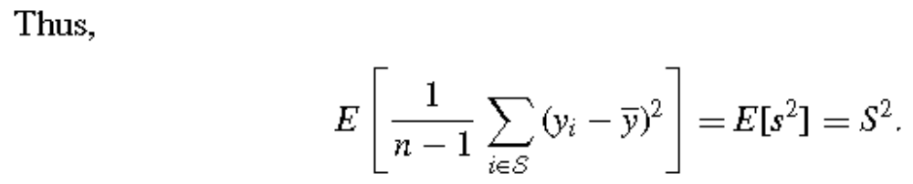
2.8 Randomization Theory Results for SRS
Condensed from Sampling: Design and Analysis 2e by S Lohr

Slide 107
2.9 Prediction Approach for SRS
In a design-based, or randomization-theory, approach to sampling inference, the only relationship between units sampled and units not sampled is that the nonsampled units could have been sampled had we used a different starting value for the random number generator.
Condensed from Sampling: Design and Analysis 2e by S Lohr

Slide 108
2.9 Prediction Approach for SRS
Model-based Approach:
  The actual values for the finite population, y₁, y₂, . . . , y_{N}, are one realization of the random variables Y₁, Y₂, . . . , Y_{N} generated from some model.
  Here, we sample {y_{i}, i ∈ S} and use these data to predict the unobserved values {y_{i}, i ∈ S}.
  Thus, problems in finite population sampling may be thought of as prediction problems.
  In an SRS, a simple model to adopt is:
    Y₁, Y₂, . . . , Y_{N} independent with E_{M}[Y_{j}] = μ and V_{M}[Y_{j}] = σ². (2.3.1)
Condensed from Sampling: Design and Analysis 2e by S Lohr

Slide 109
2.9 Prediction Approach for SRS
The subscript M indicates that the expectation uses the model, not the randomization distribution.
Here, μ and σ² represent unknown infinite population parameters, not finite population quantities.
This model makes assumptions about the observations not in the sample; namely, that they have the same mean and variance as observations that are in the sample.
Condensed from Sampling: Design and Analysis 2e by S Lohr

Slide 110
2.9 Prediction Approach for SRS
We take a sample S and observe the values y_{i} for i ∈ S.
That is, we see realizations of the random variables Y_{i} for i ∈ S.
The other “values” in the population {y_{i}, i ∈ S} are also realizations of random variables, but we do not see those.
Condensed from Sampling: Design and Analysis 2e by S Lohr

Slide 111
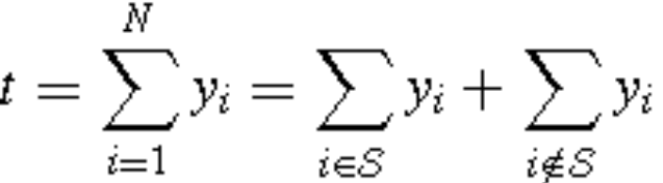
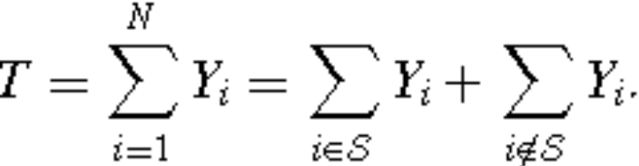
2.9 Prediction Approach for SRS
The finite population total t for our sample can be written as
and is one possible value that can be taken on by the random variable
Condensed from Sampling: Design and Analysis 2e by S Lohr

Slide 112
2.9 Prediction Approach for SRS
To estimate t for our sample, we need to predict values for the y_{i}’s not in the sample.
This is where our model of the common mean μ comes in.
We already know the values {y_{i}, i ∈ S}.
The least squares estimator of μ from the sample is , and this is the best linear unbiased predictor (under the model) of each unobserved random variable, so that
Condensed from Sampling: Design and Analysis 2e by S Lohr

Slide 113
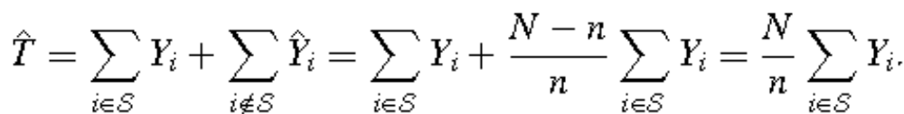


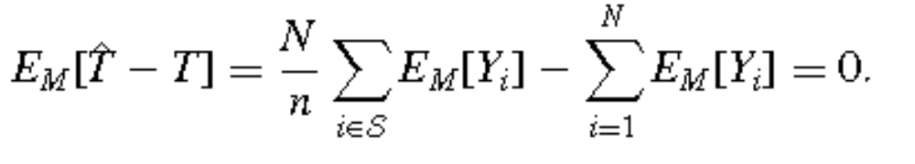
2.9 Prediction Approach for SRS
The estimator is model-unbiased:
if the model is correct, then the average of over repeated realizations of the population is
Condensed from Sampling: Design and Analysis 2e by S Lohr

Slide 114
2.9 Prediction Approach for SRS
Note the difference between finding expectations under the two different approaches:
In the model-based approach, the Y_{i}’s are the random variables, and the sample has no information for calculating expected values, so we can take the sum Σ_{i∈S} outside of the expected value.
In the design-based approach, the random variables are contained in the sample S.
Condensed from Sampling: Design and Analysis 2e by S Lohr

Slide 115
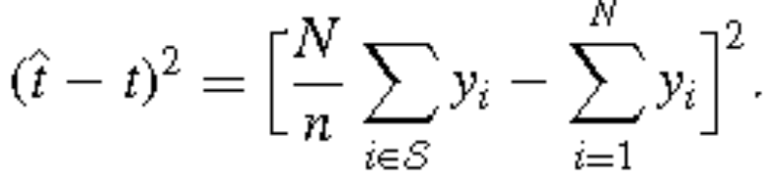
2.9 Prediction Approach for SRS
The mean squared error is also calculated as the average squared deviation between the estimate and the finite population total.
For any given realization of the random variables, the squared error is
Condensed from Sampling: Design and Analysis 2e by S Lohr

Slide 116
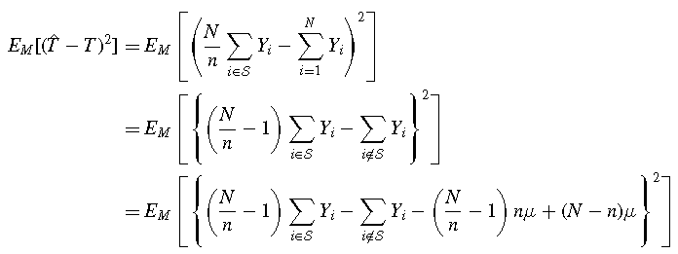
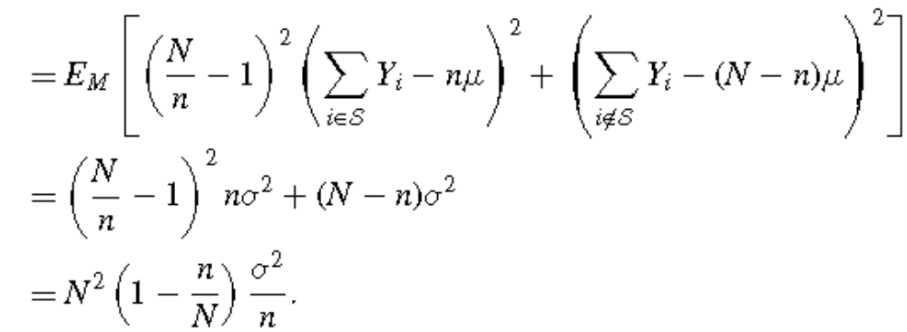
Condensed from Sampling: Design and Analysis 2e by S Lohr

Slide 117
2.9 Prediction Approach for SRS
In practice, if the model in (2.31) were adopted, you would estimate σ² by the sample variance s².
Thus the design-based approach and the model-based approach - with the model in (2.31)—lead to the same estimator of the population total and the same variance estimator.
If a different model were adopted, however, the estimators might differ.
Condensed from Sampling: Design and Analysis 2e by S Lohr

Slide 118
2.9 Prediction Approach for SRS
The design-based approach and the model-based approach with model (2.31) also lead to the same CI for the mean.
These CIs have different interpretations, however.
  The design-based CI for y_{U} may be interpreted as follows: If we take all possible SRSs of size n from the finite population of size N, and construct a 95% CI for each sample, we expect 95% of all the CIs constructed to include the true population value y_{U}.
Condensed from Sampling: Design and Analysis 2e by S Lohr

Slide 119
2.9 Prediction Approach for SRS
Thus, the design-based CI has a repeated sampling interpretation.
Statistical inference is based on repeated sampling from the finite population.
Condensed from Sampling: Design and Analysis 2e by S Lohr

Slide 120
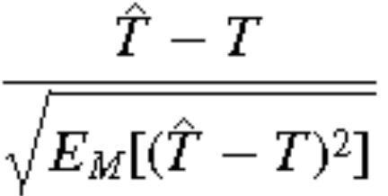
2.9 Prediction Approach for SRS
To construct CIs in the model-based approach, we rely on a central limit theorem that states that if n/N is small, the standardized prediction error
converges to a standard normal distribution
Condensed from Sampling: Design and Analysis 2e by S Lohr

Slide 121
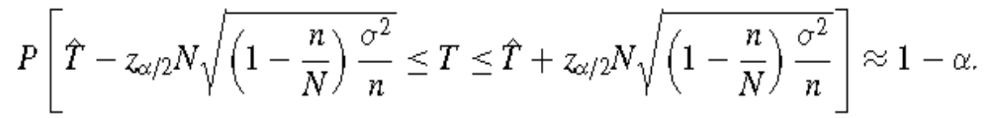
2.9 Prediction Approach for SRS
For the model in (2.31), with
this central limit theorem says that for sufficiently large sample sizes,
Condensed from Sampling: Design and Analysis 2e by S Lohr

Slide 122

Substituting the sample standard deviation s for σ, we get the large sample CI,
which has the same form as the design-based CI for the population total t.
This model-based CI is also interpreted using repeated sampling ideas.
Condensed from Sampling: Design and Analysis 2e by S Lohr

Slide 123
2.9 Prediction Approach for SRS
In the model-based approach, the probability model is proposed for all population units, whether in the sample or not.
If the model assumptions are valid, model-based inference does not require random sampling—it is assumed that all units in the population follow the assumed model, so it makes no difference which ones are chosen for the sample.
Thus, model-based analyses can be used for nonprobability samples.
Condensed from Sampling: Design and Analysis 2e by S Lohr

Slide 124
2.9 Prediction Approach for SRS
The assumptions for model-based analysis are strong—for model (2.31), it is assumed that all random variables for the response of interest in the population are independent and have mean μ and variance σ².
But we only observe the units in the sample, and cannot examine the assumption of whether the model holds for units not in the sample.
If you take a sample of your friends to estimate the average amount of time students at your university spend studying, there is no reason to believe that the students not in your sample spend the same average amount of time studying as your friends do.
Condensed from Sampling: Design and Analysis 2e by S Lohr

Slide 125
2.10 When Should a SRS be Used?
SRSs are usually easy to design and easy to analyze.
But they are not the best design to use in the following situations:
  Before taking an SRS, you should consider whether a survey sample is the best method for studying your research question.
    If you want to study whether a certain brand of bath oil is an effective mosquito repellent, you should perform a controlled experiment, not take a survey.
    You should take a survey if you want to estimate how many people use the bath oil as a mosquito repellent, or if you want to estimate how many mosquitoes are in an area.
Condensed from Sampling: Design and Analysis 2e by S Lohr

Slide 126
2.10 When Should a SRS be Used?
  You may not have a list of the observation units, or it may be expensive in terms of travel time to take an SRS.
    If interested in the proportion of mosquitoes in an island province that carry a dengue virus, you cannot construct a sampling frame of the individual mosquitoes.
    You would need to sample different areas, and then examine some or all of the mosquitoes found in those areas, using a form of cluster sampling.
Condensed from Sampling: Design and Analysis 2e by S Lohr

Slide 127
2.10 When Should a SRS be Used?
  You may have additional information that can be used to design a more cost-effective sampling scheme.
    In a survey to estimate the total number of mosquitoes in an area, an entomologist would know what terrain would be likely to have high mosquito density, and what areas would be likely to have low mosquito density, before any samples were taken.
    You would save effort in sampling by dividing the area into strata, groups of similar units, and then sampling plots within each stratum.
Condensed from Sampling: Design and Analysis 2e by S Lohr

Slide 128
2.10 When Should a SRS be Used?
You should use an SRS in these situations:
  Little extra information is available that can be used when designing the survey.
    If your sampling frame is merely a list of university students’ names in alphabetical order and you have no additional information such as major or year, simple random or systematic sampling is probably the best probability sampling strategy.
Condensed from Sampling: Design and Analysis 2e by S Lohr

Slide 129
2.10 When Should a SRS be Used?
  Persons using the data insist on using SRS formulas, whether they are appropriate or not.
    Some persons will not be swayed from the belief that one should only estimate the mean by taking the average of the sample values—in that case, you should design a sample in which averaging the sample values is the right thing to do.
    SRSs are often recommended when sample evidence is used in legal actions; sometimes, when a more complicated sampling scheme is used, an opposing counsel will try to persuade the jury that the sample results are not valid.
Condensed from Sampling: Design and Analysis 2e by S Lohr

Slide 130
2.10 When Should a SRS be Used?
  The primary interest is in multivariate relationships such as regression equations that hold for the whole population, and there are no compelling reasons to take a stratified or cluster sample.
    Multivariate analyses can be done in complex samples, but they are much easier to perform and interpret in an SRS.
Condensed from Sampling: Design and Analysis 2e by S Lohr

Slide 131
End of Chap 2
Condensed from Sampling: Design and Analysis 2e by S Lohr

